Slide 1
INFO6150 Final Presentation
Money Saver
002144061 Chun Lee
002199242 Hanwen Jiang
001005743 Haoyang Hu
002981985 Sheng-Jung Chen

Slide 2
Background
There is a popular saying that “the easiest way of becoming bankrupt is by not paying attention to your expenses.” There is nothing that captures the importance of keeping track of your expenses better than that saying.When you know how much money you spend, it’s easy to balance your income with your spending and even save for the future.
Money Saver is a web-app that helps in tracking expense and income and visualize the data

Slide 3
Use cases
User can sign up and login in with email and password.
User can see his profile and account summary after logging in.
User can view his expense and income history.
User can type to search for the specific expense or income record.
User can create, update and delete a expense.
User can create, update and delete a income.

Slide 4
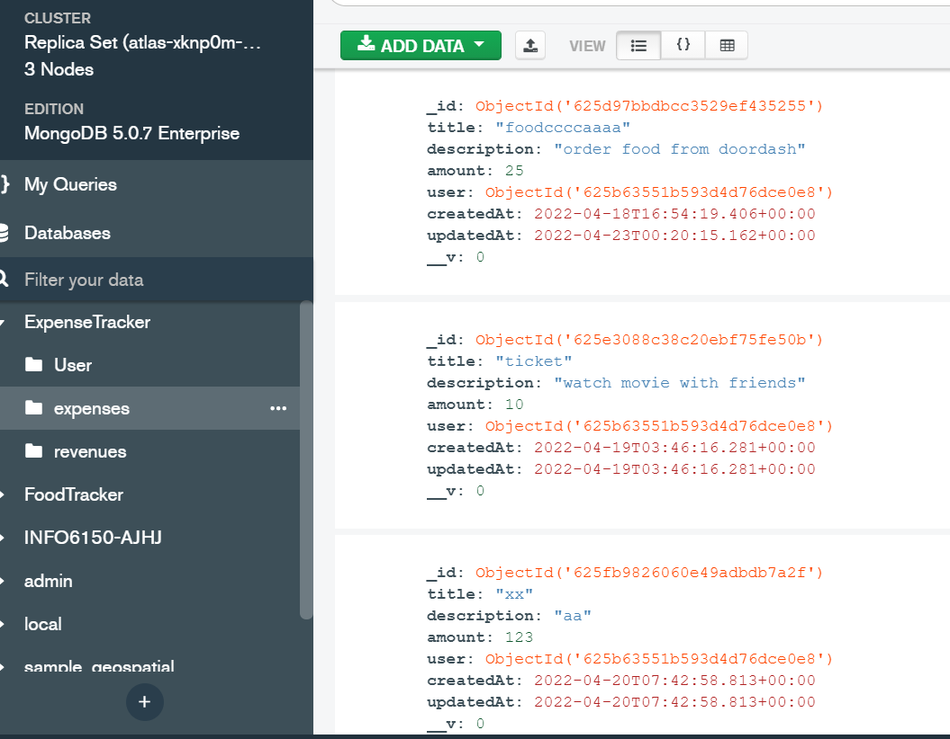
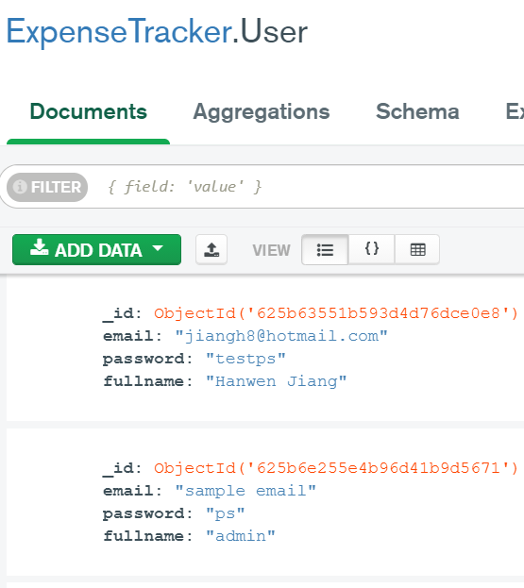
Database & Collections

Slide 5
Tech Features
Built using React.JS, react-bootstrap and Redux as State Management
Control.
Appropriate Flow for User Signup & User Login with Yup Authentication
Node.js Express Architecture with CORS, Authentication & Middleware
Used Mongoose to interact with MongoDB Database.
Axios making HTTP requests to fetch or save data client-side.
Used HTTP REST API for searching and retrieving income and expense records.
Used Chart API for data visualization for income and expense records.

Slide 6
Contribution
Haoyang Hu: Register & Login, AccountSummary API, Search API,
History view, Add function, Edit function, Delete function,
Search function, UI in Expenses edit
Chun Lee: Add Expense UI, Add Income UI, HomePage UI, NavBar UI,
Register & Login UI
Hanwen Jiang: most of the REST API, user profile and user account summary
implementation
Sheng-Jung Chen: Income add & UI, Income edit & UI, view Income history,
Income delete, Income search & UI, profile UI

Slide 7
Future work
System security can be improved such as the password hashing
User can also upload their photos to their personal profile
We can also implement user’s weekly, monthly and year report
Email notification

Slide 8
References
https://www.chartjs.org/docs/latest/developers/api.html
https://axios-http.com/docs/intro
https://www.youtube.com
https://developer.mozilla.org/en-US/
https://getbootstrap.com
https://redux.js.org
https://reactjs.org

Slide 9
Thank You!

